Slide 1
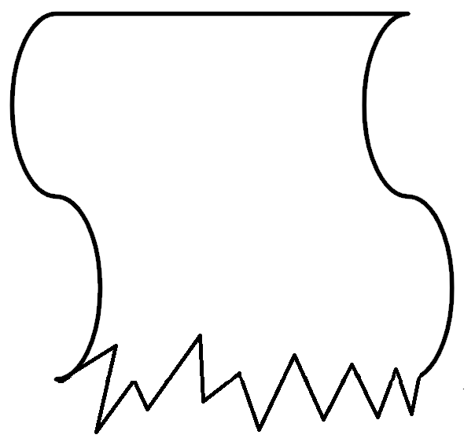
Checking by estimating
Task A: Estimating answers
1) A rectangle has dimensions 145 m by 18.4 m.
Which calculation would give a suitable estimate for the area of the rectangle? Explain why you think it is a suitable estimation.
a) 150 × 18
b) 150 × 20
c) 100 × 20
d) 18 × 145
145 m
18.4 m
This is suitable because each number has been rounded to 2 s.f.
This is suitable because each number has been rounded to the nearest 10
This is suitable because each number has been rounded to 1 s.f.
This is suitable because each number has been rounded to the nearest integer.
2) Here are 3 damaged receipts. Each pupil pays with a £20.
Aisha gets £12.23 change. Jacob gets £6.89 change. Sam gets £9.11 change. Only using estimation, which student went to which shop?
Shop A
Shop B
Items
Shop C
Items
Price
Items
Price
Price
Calc £5.12
Pencil £1.02
USB £5.03
Pencil £0.78
Stamps £7.83
Paper £0.28
Ruler £1.89
Label £2.99
Pens £0.91
Paper £3.10
Crisps £1.27
Pencil £0.56
To tal
To tal
Crisps £0.99
To tal
Estimating
£5 + £1 + £2 + £3 = £11
Approximate change expected £9.
Sam went to Shop A
Estimating
£1 + £8+ £3 + £1 = £13
Approximate change expected £7.
Jacob went to Shop B
Estimating
£5 + £0.30+ £1 + £0.50 + £1= £7.80
Approximate change expected £12.20.
Aisha went to Shop C

Slide 2

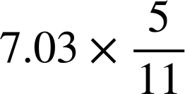
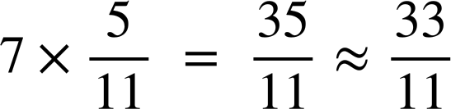
Checking by estimating
3) Another receipt was damaged. Jun remembers paying with a £50 note and receiving about £3 back in change. Estimate how much the board game was. You must show your working out.
Items
Price
Estimating
£5 + £8 + £1 + £2 + £5 + £9 = £30
Given the change from £50 was £3
£50 - £33 = £17
The board game was approximately £17
Stamps £5.31
Calc £8.12
Pencil £0.94
Ruler £1.89
Paper £4.50
USB £8.59
B. Game £
To tal
Task B: Checking answers
1) Using estimation only, put a tick with the calculation which gives the approximate correct answer. Where the answer is incorrect, identify the error.
Buying 34 books each costing £21.32 £700
A rectangle with lengths 3.21 cm by 9.56 cm has an area 30 cm²
35 × 20 = 700
Area = 3 × 10 = 30
A square with length 8.23 mm has a perimeter 64 mm
There are approximately forty five 50p pieces in £91.
Area = 8 × 8 = 64
Perimeter = 8 + 8 + 8 + 8 = 32
45 × 0.5 = 45 ÷ 2 = 22.5
Or 90 ÷ 0.5 = 90 × 2 = 180
2)
Is approximately:
Make sure to show your reasoning or working out.
6
14
3
4
Not possible to estimate
There are a few ways to determine this approximation.
Example, is slightly below a half so a little below half of 7 is 3.
Example is rounding giving an approximate answer of 3

Slide 3
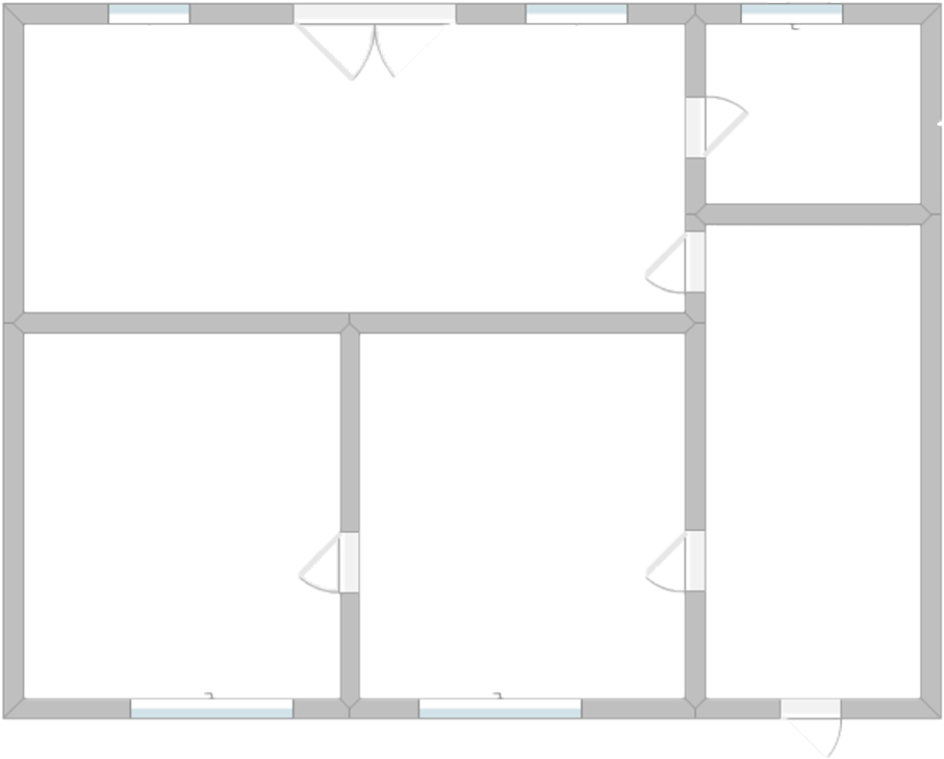
Checking by estimating
3) Here is a floor plan of a one bedroom apartment. The Oak teacher spots an error with a measurement given.
a) Can you find the error? Estimate what the correct measurement should be.
18.47 m²
3.77 m²
7.03 m
11.18 m²
11.49 m²
92.4 m
9 m. Accept anything between 8 m and 12 m inclusive.
b) Can you estimate the area of the missing room?
Estimating the length to be 9 m, the total area is expected to be
7 × 9 = 63.
Therefore, rounding and subtracting the other areas
63 - 20 - 4 - 11 - 11 = 17 m².
Accept anything between 15 m² and 20 m² inclusive.
Mathematics in Education and Industry
v2.3

